Slide 1
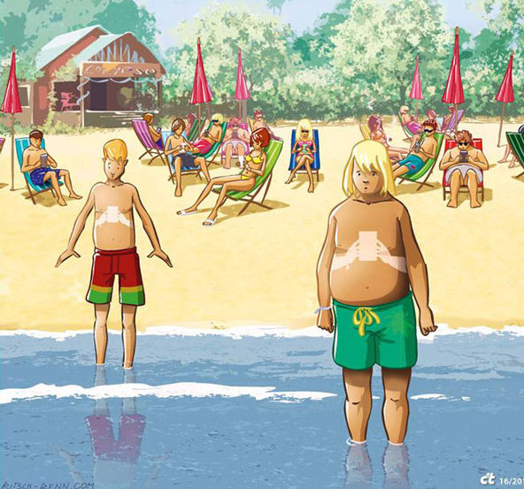
MEDIA, TECHNOLOGY AND KIDS
Morton Street – Tuesday, April 24

Slide 2
Morton Street Workshops
Parent Survey, Student Survey
Tuesday, March 13 - Parent Session #1
Thursday, March 15 and Friday, March 16 – Student Workshop #1
Homework assignment
Monday, March 26 and Tuesday, March 27 – Student Workshop #2
Tuesday, April 24 – Parent Session #2

Slide 3
Parent Survey
What rules do you have in your home about social media use?
What is your biggest concern regarding your children and their media and technology use?
What is one question you would want to ask an expert regarding media and technology and kids?
Do you allow your 6th grader to have social media? If so, which ones?
What is one thing you wish your children knew about social media?

Slide 4
Parent Survey Results Heard from 59 people!
What rules do you have in your home regarding media and tech?
Time limits
School week/weekend rules
HW/chores needs to be done
Private accounts
Content limitations, some sites blocked
No phones in bedroom at night
Parental restrictions

Slide 5
Questions
How much is too much?
What is the attraction to social media?
What is my job as a parent and what is not my job?
How do I monitor without invading privacy?
What impact is social media having on my kid?
How do I not let it completely control the mood in my house and the arguing over not using it?
How do I explain that I can be on my phone but she cannot?
How do I keep them safe?
How do I convince them to do other things when nothing is more interesting then their device?
What limits should I set?

Slide 6
What is your biggest concern?
Not socializing properly, no social skills
Not reading as much as they should
Addiction
Bullying
Kids won’t learn to be bored
Peer pressure
Digital footprint, permanence
Pornography
Stranger danger
Inappropriate behavior
Inappropriate content
Hard to keep up
Short attention span
Wasting time
Bad posture
Effect on their brains
Commercialism
Over stimulation
Depression
Over sharing
FOMO
Body image issues

Slide 7
What social media use is happening at Morton Street?
Instagram
Snapchat
Texting
YouTube
Musically
Email
Video games
Pinterest
Twitter

Slide 8
Student Survey
When you hear the words social media what do you think of?
What social media accounts do you have if any?
If you don’t have any social media accounts, why?
If you do have social media accounts, do you have rules in your home about using the accounts? If yes, what are they?
What is your favorite thing about social media? (Please answer this even if you don’t personally have any accounts.)
What is your least favorite thing about social media? (Please answer this even if you don’t personally have any accounts.)
What is the one thing you would change about social media?
What do you wish adults knew about social media?

Slide 9
When you hear the words social media what do you think of?
Instagram
Creativity
Internet/Phone
YouTube
Twitter
Apps
Whatsapp
Fun
Pictures, interacting with people from across the world
People who chat or talk on different technical platforms
Idiots
People being famous
Pictures and likes
A place where you show your life and people that follow you see it
Bad stuff
Media that is social. It’s pretty self explanatory.
Electronics

Slide 10
What social media accounts do you have if any?
YouTube, Email
Snapchat
Musically
Instagram
Pinterest
Whatsapp
Xbox
Twitter
Facebook
Google
Skype

Slide 11
If you don’t have any social media accounts, why?
No, because I don’t like the idea.
Don't want one.
I have no social media accounts because I think showing your identity to strangers is stupid.
I don’t get into that stuff.
I never did like befriend/stranger people and never trusted those people.
Hacking.
Because they are useless and they ruin your brain with stupid stuff.
I don’t believe in it.
I don't have any. My parents don’t let me use it.
My parents think it’s a waste of time posting about your “fabulous” life.
I don't have any because it wastes time and it just doesn’t interest me.
Dangerous.
I don't want to get hacked.
I don’t care for it.
The reason I don’t have it is because I find social media boring
My mom is European and she doesn't believe in social media.
I don’t like it because there are child predators and haters cause people to commit suicide.

Slide 12
If you do have social media accounts, do you have rules in your home about using the accounts? If yes, what are they?
Be careful with who you interact with
Don’t be rude or inappropriate
Follow people you only know
Certain hours
Don’t show my face on anything public for my safety
Parents have to approve of posts and friends
No cursing
Be private
Be careful of what you watch
No sex websites
No creepy people
Not on school nights
HW first
Never trust strangers
Don’t tell location
“I mean if a stranger comes and trolls me they join the beautiful block list.”
THINK
My parents have to follow me
No phones at dinner table
No posting videos on youtube

Slide 13
What is your favorite thing about social media? (Please answer this even if you don’t personally have any accounts.)
The fact that you can learn things and be more creative
My friends have it and I can see them
Being able to talk with friends especially if you haven’t seen them in awhile
You express yourself
Record YouTube Videos
Checking other friend’s posts
Snapchat because of the cool filters
Being able to get in contact with friends
Getting to see what my friends are up to
You meet new people
You get to know what’s happening around the world
Games, texting, YouYube
People posting beautiful artwork and scenic views
Friends, funny vines
Connecting
I like taking photos and sharing them with my friends and it’s a way to communicate
I like taking artsy photos and sharing them with my friends. I can chat with my friends that don’t have a number.
It’s an expanded form of group chats
You can see what your family far away is doing and they can see what you are up to
I get to share my life
The magic of how random things can be
Celebrities roasting each other
It’s a good place to share your hobbies
Editing photos
It can give you info fast
It always has new content
You can show the world what you experience
Seeing my little cousin on Instagram
I like it because you don’t have to make a professional movie just to share videos
I can do my homework and access interesting information

Slide 14
What is your least favorite thing about social media? (Please answer this even if you don’t personally have any accounts.)
Predators, glitches, hate
Cyberbullying
No privacy
People can be idiots
What mean people say
Hacking
I really dislike when people can see your location and text or call you.
You can’t take anything back
Wasting time
It’s a little too addictive
Porn
People can kidnap people
Scammers
Sometimes you might accidently see something inappropriate that someone else has posted
When friends post too much
Remove ads
Too many notifications
My least favorite thing is that it can cause people pain because they could look at someone and get mad at themselves because they are not like that.
You can get upset if you don’t have a lot of likes.
Catfishing
Spam
Cringey people
Everyone can judge you
I can get very jealous
Violence

Slide 15
What is the one thing you would change about social media?
The hate that people can spread
People say only positive
The mean people, cyberbullying
Hacking
It would automatically block comments and people that are cyberbullies
Your phone tracker but only your parents can use it
It could automatically block bad people and mean comments
When people post at a party you were not invited to
Take away inappropriate websites
Posting only artwork
Paul brothers
That random people can talk to you if you don’t have a private account
No scammers
Weird accounts should be immediately blocked
If you are public, you can still block weird people
I would make it so you couldn’t give hate comments
No stalking
I would make it less addictive
Delete Trump’s account
There should be background checks
I would change the policy to no kids under 11
Allow kids not to use it
I would make it more safe and secure
If you delete something then it will be deleted and no one can see it

Slide 16
What do you wish adults knew about social media?
That it is a way to express yourself.
About cyberbullying
That it is not a waste of time
That there is more good stuff than bad stuff
It’s really fun
Snapchat is the best app
That they knew about social interactions people have or things that make people depressed
That it is dangerous to be friends with a stranger
Most don't understand it and can’t use it
That you can block bad people
If you block people they can’t see your photos
I wish adults would understand that social media was a procrastinating excuse
Kids like social media and they are responsible
It can be useful and helpful with certain things
Trust us!
It’s horrible, dangerous.
Social media is where kids open up to have fun and to understand social media is not all bad.
It helps me escape my depression.
I wish they knew about bad people.
How to use it
I am responsible on social media
Sometimes social media isn’t always inappropriate and that we can make private accounts
I wish adults can see the pros and cons about social media

Slide 17
Parent Session #1
Discussed parent surveys and overall concerns parents have
Not all media are created equally
Adolescents yesterday and today
What we know
We spend a lot of time with media.
Media impact us.
Media can be positive.
Media can be negative.
There is risk with media use.
There is opportunity with media use.
Parents are worried and overwhelmed.

Slide 18
Parent Session #1 (cont.)
Current debates about kids and technology
Tech Company Responsibility
Tech Addiction
Screen time
Depression
Anxiety
Privacy
There is NO scholarly consensus on any of these issues.

Slide 19
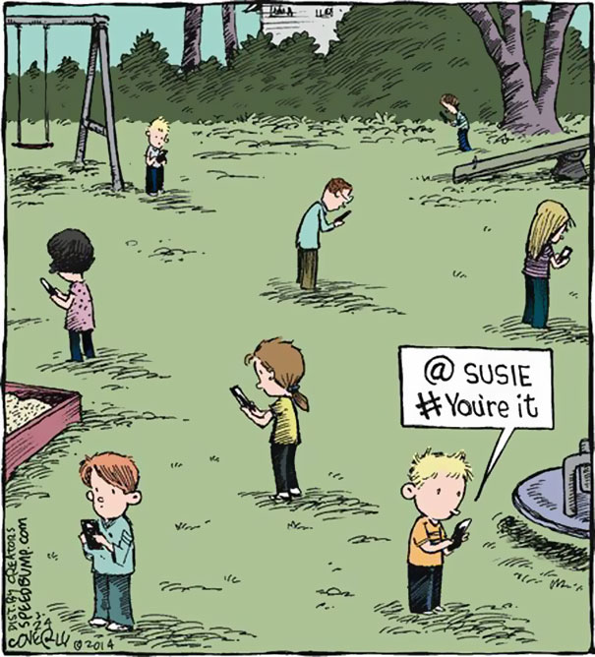
The 6 Es
Exemplify
Explain
Engage
Empathize
Educate
Empower

Slide 20
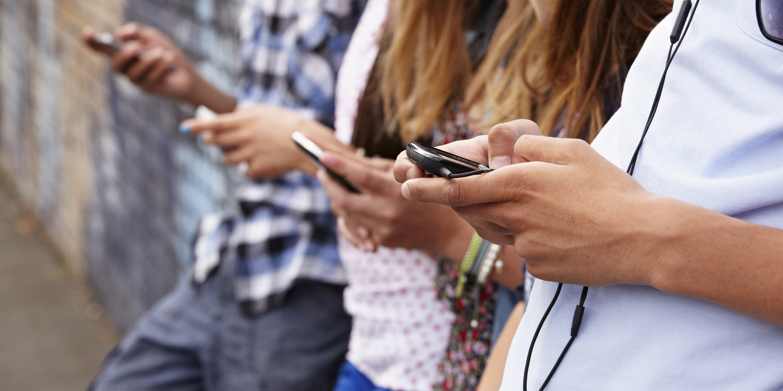
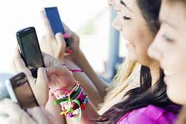
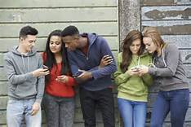
Media, Technology and You
75 Morton Street
Student Workshop Session 1

Slide 21
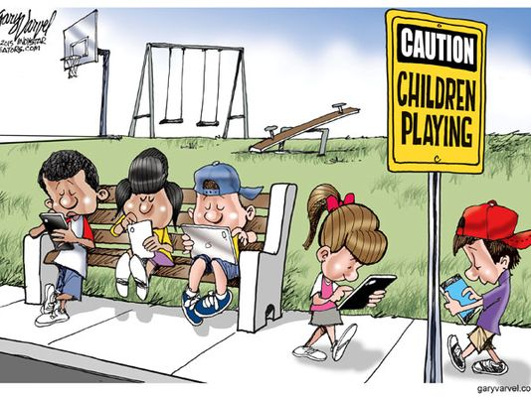

Slide 22
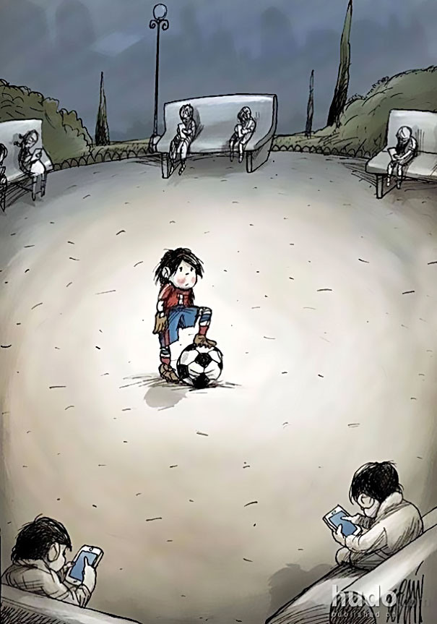

Slide 23
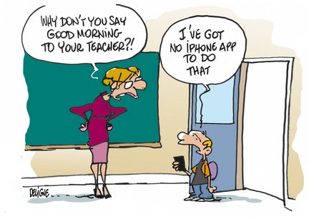

Slide 24
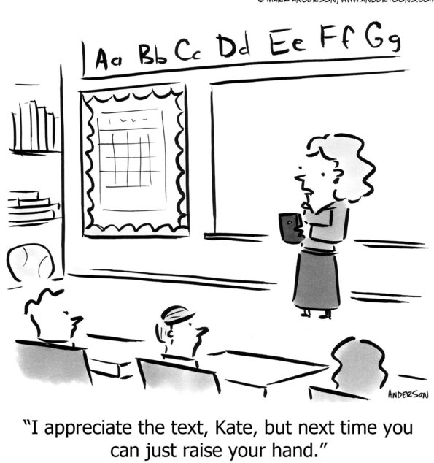

Slide 26
Digital citizenship is membership in a digital community. Digital citizens are those that use the Internet regularly.

Slide 27
A digital footprint is the information about someone that exists on the Internet as a result of their online activity.

Slide 28
Screen Digital Citizenship Video

Slide 29
What do these images have to do with digital footprint?
Lighthouse
Copies and whispering in the ear
Stadium/Jumbotron
Permanent Marker

Slide 30
Digital Footprint Quiz
True or false: Your digital footprint is all the information about you online that only you post.
True
False

Slide 31
Digital Footprint Quiz
True or false: Your digital footprint is all the information about you online that only you post.
True
False

Slide 32
Digital Footprint Quiz
What kinds of information can make up a
digital footprint?
Online photos
Comments that others post about you
Both a and c

Slide 33
Digital Footprint Quiz
What kinds of information can make up a
digital footprint?
Online photos
Comments that others post about you
Both a and c

Slide 34
Digital Footprint Quiz
What kinds of information would make a
POSITIVE digital footprint?
Photos of you doing work in the community
A newspaper article about your soccer team
A mean comment that you made on a friend’s website
A blog you created to showcase your artwork
Inappropriate photos of you on a social network site

Slide 35
Digital Footprint Quiz
What kinds of information would make a
POSITIVE digital footprint?
Photos of you doing work in the community
A newspaper article about your soccer team
A mean comment that you made on a friend’s website
A blog you created to showcase your artwork
Inappropriate photos of you on a social network site

Slide 36
Trillion Dollar Footprint
Today you’re all producers for “Trillion Dollar Footprint,” a popular TV show that tours the country looking for teens to compete in a nationwide talent show. You’re looking for a new host for the show.

Slide 37
Who should be the host?
Do you think the show’s host should be Linda or Jason? Why?
Do you think the candidate will be honest?
Do you think the candidate will work well with others?

Slide 38
Reflection
Who helped to shape Linda’s and Jason’s digital footprints?
Can you tell what a person is really like offline based on what you find online?
What are some other types of information that make up your digital footprint?

Slide 39
Homework
Read article “Good Things are Happening Online” with your parent or guardian and answer questions.
Create your future digital footprint.

Slide 40
HomEWORK – Good tHINGS ARE HAPPENING ONLINE
Do you agree with the approach the author takes regarding social media? Why or why not?
What positive activity have you seen on social media or the Internet recently?
What could you add to the 2018 to do list to help create a healthy relationship with media and technology in your home?

Slide 41
HomEWORK – Good tHINGS ARE HAPPENING ONLINE
Do you agree with the approach the author takes regarding social media? Why or why not?
Yes, it’s easy to overlook the benefits of technology.
Everyone always talks about the negative effects but no one talks about all the good that comes from social media.
Yes and no because social media can be a good and bad thing at different times and for different people.
Not necessarily – people might look good on social media but not in real life
I (student)think yes because SM is a good opportunity to get in touch with old friends. My dad disagrees because he thinks friendships should stay strong without social media.
Instead of taking screens away, you should teach your kids how to do good with it.

Slide 42
HomEWORK – Good tHINGS ARE HAPPENING ONLINE
What positive activity have you seen on social media or the Internet recently?
#neveragain, March for Our Lives, School Walk Out, Gun Control
Florida has been transformed in our imaginations. No longer just a place of palm trees and sunsets. Now Floriday is the nerve center of a revolution.
International Women’s Day
#metoo
Helping the Homeless
DIY projects, How to (ie. Cook)
Helping animals
Celebrities doing good
Fundraisers
You Tube video that helped me with my homework
Talking and connecting.
My mom’s friend Emily volunteering in Cambodia.

Slide 43
HomEWORK – Good tHINGS ARE HAPPENING ONLINE
What could you add to the 2018 to do list* to help create a healthy relationship with media and technology in your home?
Delete everything off your phone that you realize that you do not do at all.
Time limits for parents. Parents need to look at our own social media habits.
Stop thinking negatively about social media. Look on the bright side!
Be a good influence. Make others feel good.
Post something together. Share a bond.
Show mom new technology things.
Mom could put down her phone.
Set aside time each week for the two of us to talk about SM use and why.
You can add: 1 hour a day if you read 1 hour a day.
Put school before SM.
Continue open lines of communication.
Look at it with me.
*Make sure your kids are getting digital and media literacy lessons in school. Take time to talk to your kids about their digital lives. Put down your phones and model connecting IRL.

Slide 44
HomEWORK – Digital FOOTPRINT

Slide 45
HomEWORK – Digital FOOTPRINT

Slide 46
Media, Technology and You
75 Morton Street
Student Workshop Session 2

Slide 47
Essential Question 1
Do people ever express parts of their identities online that they might not express offline?

Slide 48
Essential Question 2
Have you ever heard of people who exaggerated something about themselves online?

Slide 49
Essential Question 3
Have you ever heard about people who deceive others by pretending to be someone else while they were on the Internet? Why do you think they did this?

Slide 50
Scenario 1
Alejandro wants good reviews and comments on his YouTube videos, so he creates several user names. He uses them to leave good comments about his own videos.

Slide 51
Scenario 2
In real life Phil is a quiet, shy guy. But when he’s texting he feels more outgoing than in person, and sometimes he says things he normally wouldn’t say. A girl who has the same math teacher as Phil texts him asking for the answers to the math quiz: “hey cutie phil ... giv me quiz answers PLZ!!” Phil likes the girl and wants to be her friend, but he would never share answers in person, and he knows he could get in trouble. He decides to text her the answers anyway.

Slide 52
Scenario 3
Emma likes to play EscapeGo, a virtual game world where players use avatars to play. She pretends to be a boy and uses a male avatar because she thinks she’ll be more accepted by the other players. She interacts with others in the game through her avatar, and she has made a couple of really close friends through the game.

Slide 53
Which of the following is an example of a RISKY way to present oneself in a different way online?
a) Raquel creates an avatar in a virtual world with pink hair, even though her hair is brown in real life.
b) Dan’s profile picture is an image of his dog.
c) Nick lies to someone he meets online by saying he’s in college.

Slide 54
Which of the following is an example of a RISKY way to present oneself in a different way online?
a) Raquel creates an avatar in a virtual world with pink hair, even though her hair is brown in real life.
b) Dan’s profile picture is an image of his dog.
c) Nick lies to someone he meets online by saying he’s in college.

Slide 55
On Lucy’s social networking profile, she posts that she is older than her real age and that she likes rock music, which she actually doesn’t like. Which of the following might be a possible consequence of how Lucy presents herself online?
a) Lucy might get attention from older people who think she is the age she has posted.
b) People might start talking to Lucy about rock music.
c) Both a and b

Slide 56
On Lucy’s social networking profile, she posts that she is older than her real age and that she likes rock music, which she actually doesn’t like. Which of the following might be a possible consequence of how Lucy presents herself online?
a) Lucy might get attention from older people who think she is the age she has posted.
b) People might start talking to Lucy about rock music.
c) Both a and b

Slide 57
Evan likes Maria, but she is dating Josh. Evan pretends to be Maria online and posts angry messages on Josh’s blog so that Josh thinks she is mad at him. Evan is ________ Josh by pretending to be Maria.
a) deceiving
b) helping
c) motivating

Slide 58
Evan likes Maria, but she is dating Josh. Evan pretends to be Maria online and posts angry messages on Josh’s blog so that Josh thinks she is mad at him. Evan is ________ Josh by pretending to be Maria.
a) deceiving
b) helping
c) motivating

Slide 59
What kind of community do you want to create?
#icanhelp videos

Slide 60
75 MORTON STREET MEDIA AND TECH PROMISE
We, the students of Morton Street, promise to….
1)
2)
3)
We, the adults of Morton Street, promise to…
1)
2)
3)

Slide 61
75 MORTON STREET MEDIA AND TECH PROMISE
We, the students of Morton Street, promise to….
Be positive on social media
Respect other people’s feelings
Be honest
Be kind
Be comforting and make the right choices
Always leave a positive digital footprint
Think about everything we do online and remember that whatever we do is there forever Be your true self
Remember to represent the community
Be mindful of people’s privacy
Pay attention to what you post online
Promise to always be safe
Promote and encourage self-esteem
Treat people equally no matter gender, race, religion, etc.
Post responsibly
Block bad people
Share safe, appropriate, and valid information online
Try to have positive effects in your videos or pictures. Help the community to stay positive
Only follow people we know and our role models
Act like you’re being watched by your mother

Slide 62
75 MORTON STREET MEDIA AND TECH PROMISE
We, the adults of Morton Street, promise to…
We want you to help us get through a difficult time when something happens online
Let us explore how social media can help us to have good effects on our lives
Give their child a positive perspective of a digital life and how to handle one
Check in with students experience and thoughts of social media, not only read or learn of negative experiences from one website/perspective
Help build the positive digital footprint their child wanted while building a healthy social school life
Observe within a distance, not too protective
Trust us kids
Be more supportive
Teach us what not to do and what to do
Make sure kids know that online friends are much different than real life friends
Be good examples for the children
Be kind, honest
Make kids use less screen time
Help us be as safe as possible
Act your age online
Be patient

Slide 63
75 MORTON STREET MEDIA AND TECH PROMISE
We, the adults of Morton Street, promise to…
Let kids express themselves on the internet
Give us more freedom on the internet
Give us more privacy
Make sure kids are being kind
Stop bullying
Monitor our posts and give us privacy
Make sure not to stalk your kids
Follow the rules
To understand that technology can be good
If they are going to post a picture of us ask permission
I think the adults should make a school blog about good kids in Morton to raise self confidence.
Try not to hover over us when we are using tech instead try and trust us
Be aware that your child might be bullied
Let us start a Morton insta account
Hear children’s ideas

Slide 64
WHAT DID WE LEARN?
Kids have a lot of interest and a lot of energy for this topic.
Kids are very savvy about people’s behavior online.
Kids understand many of the risks.
Kids are clear about the rules.
Kids understand that everything they put online stays on line.
Parents doing a good job outlining risks and setting guidelines.

Slide 65
WHAT DID WE LEARN?
Kids want their parents to be more understanding and more helpful
Kids want privacy but also want guidelines
There was a lot of negativity, fear, and cynicism.
Never heard so many students say “it’s a waste of time” or talk about worse case scenarios: “getting kidnapped” and “killed”
It was difficult to get the kids to talk about the positive side of media and technology.

Slide 66
What I RECOMMEND
In general, we need to do a better job balancing the conversation in the community.
Create a POSITIVE relationship. Rather than “don’t do this” say “do this”.
Teach them without making them so afraid.
Prepare them, talk to them, explain from a place of opportunity.
Exemplify, Explain, Engage, Empathize, Educate, Empower
Complete the Morton Street Promise
Make this a priority in your community.

Slide 67
A Note ABOUT…
Fortnite
Mature (13+ on CSM), public chat, many older people playing
Do research and talk to your kids.
https://www.commonsensemedia.org/blog/parents-ultimate-guide-to-fortnite
https://www.commonsensemedia.org/game-reviews/fortnite
Paul Brothers (Jake and Logan 31 Million YouTube followers)
Logan Paul (over 17 million YouTube followers) was blasted on social media this New Year's Eve after he posted a YouTube clip of himself visiting the famous Aokigahara "suicide woods" in Japan – a video that included footage of a man who had recently hanged himself.

Slide 68
The 6 Es
Exemplify
Explain
Engage
Empathize
Educate
Empower

Slide 69
Exemplify
Be a role model
Kids are often technically savvy.
Adults have more life experience.

Slide 70
Explain
Outline your expectations
Talk about technology
before you purchase it
Set guidelines and rules before usage
Be proactive not reactive

Slide 71
Engage
Talk about the media they use
Discuss movies, TV programs, You Tube videos
Tell them about the media you like
Ask questions
Make sure your conversations aren’t only about what they shouldn’t be doing

Slide 72
Empathize
Kids are growing up
in a public space.
We made mistakes in private.
Kids today don’t have that luxury.
Consequences are far greater.
Notes:
Teens often see privacy as a trust issue with their parents. Part of the core difference between parents and teens.

Slide 73
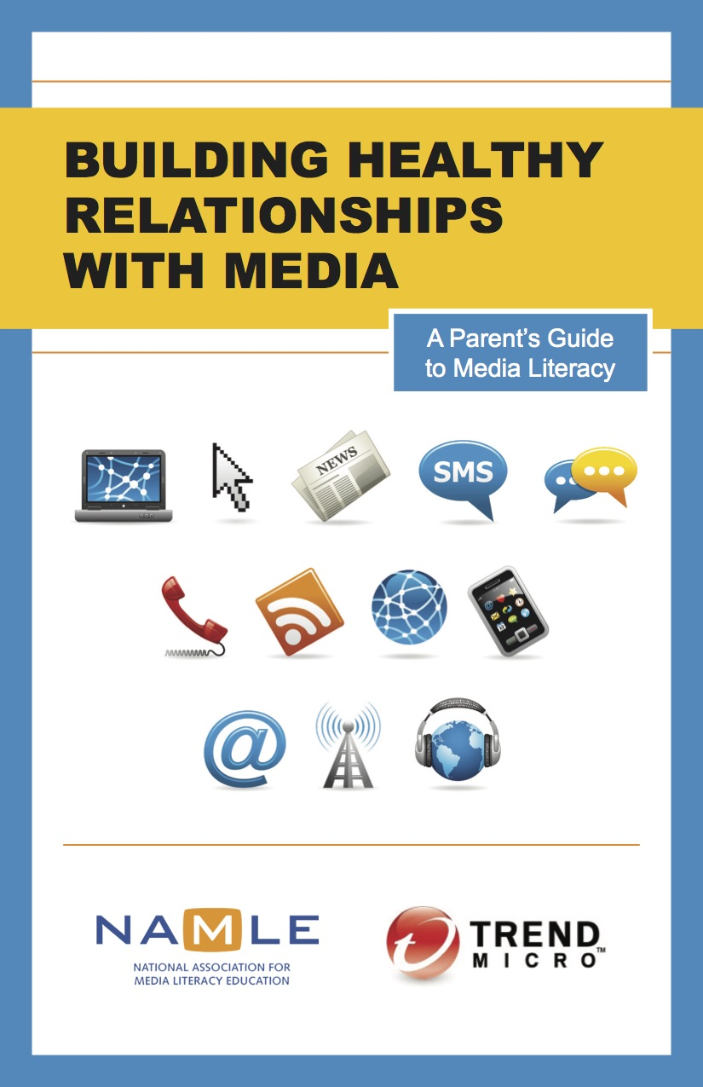
Educate
Prepare vs protect
Teach vs tell
Learn how to have media
literacy conversations in
the home

Slide 74
Empower
Encourage their media creation
Tell them about new apps, new sites
Sign them up for classes
Teach them new skills

Slide 75
It’s not our job as parents to put away the phones. It’s our job to take out the phones and teach our kids how to use them. - A. Samuel, The Atlantic

Slide 76
Michelle Ciulla Lipkin
Executive Director
mciullalipkin@namle.net

